Slide 1

REAL-TIME ANALYTICS DASHBOARD
Podutur Lahari - DE126 Tejaswini Gokanakonda - DE142

Slide 2


Project Overview
This project involves building a real-time analytics dashboard using Azure Databricks and
PySpark to handle and analyze streaming data.
The data is processed and transformed using PySparkSQL to derive actionable insights. The processed results are then visualized in real-time using Databricks Notebooks or integrated with visualization tools like Power BI or Tableau for advanced dashboards.
This project showcases the seamless integration of big data processing with interactive visualizations to monitor trends, detect anomalies, and support decision-making in real-time.

Slide 3

Introduction
A Real-Time Analytics Dashboard is an interactive tool designed to monitor, analyze, and visualize streaming data as it is generated, enabling immediate insights and decision-making.
They are widely used in domains like finance, healthcare, e-commerce, and IoT, where timely responses to data changes are critical. These dashboards integrate data ingestion, processing, and visualization to present live updates, detect trends, highlight anomalies, and improve operational efficiency.

Slide 4



Dataset Overview
Dataset source
Kaggle
Columns :
RowNumber.
Customer_Id Surname CreditScore Geography Gender
Age
Tenure Balance
Num Of Products IsActiveMember EstimatedSalary Exited
Dataset size
10,000 rows and 13 columns
Description
The dataset contains customer data for a credit card company, with fields relevant to customer demographics, financial details, and account activity. This data is ideal for analyzing customer behavior and trends in real-time.

Slide 5
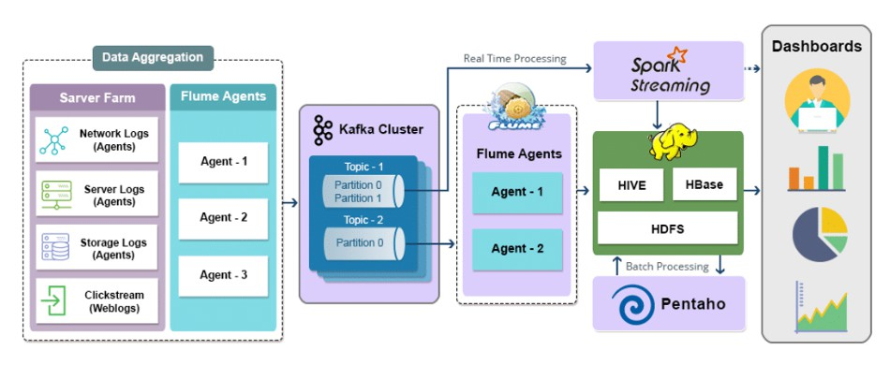
Architecture Diagram

Slide 6
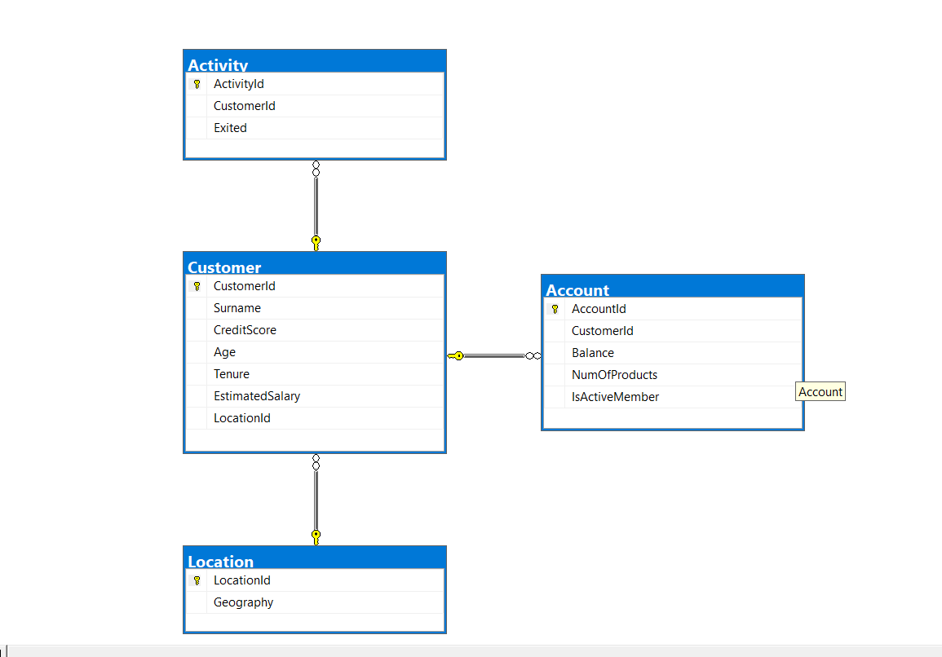
ER Diagram

Slide 7

Execution Overview
The Real-Time Analytics Dashboard project ingests customer data (e.g., demographics, transactions, and credit scores) into Azure Databricks using streaming data sources like Azure Event Hubs or Kafka.
PySpark processes and transforms this data, applying analytics to calculate key metrics, such as churn risk and account balance trends. Data is stored in Azure Blob Storage or Delta Lake for efficient querying.
Real-time insights are visualized using Databricks Notebooks or external tools like Power BI. Monitoring and alerting features are set up to track key metrics, while the solution is optimized for scalability and performance using cluster-based processing.

Slide 8
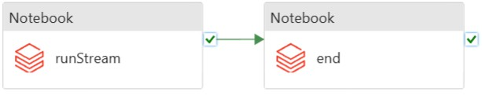
ETL Pipeline

Slide 9

Azure Databricks
Azure Data Factory (ADF)
Azure Blob Storage / Azure Data Lake Storage
Azure Event Hubs / Apache Kafka
Azure SQL Database / Delta Lake
Power BI / Tableau Azure Monitor
Azure Resources Used for Project

Slide 10

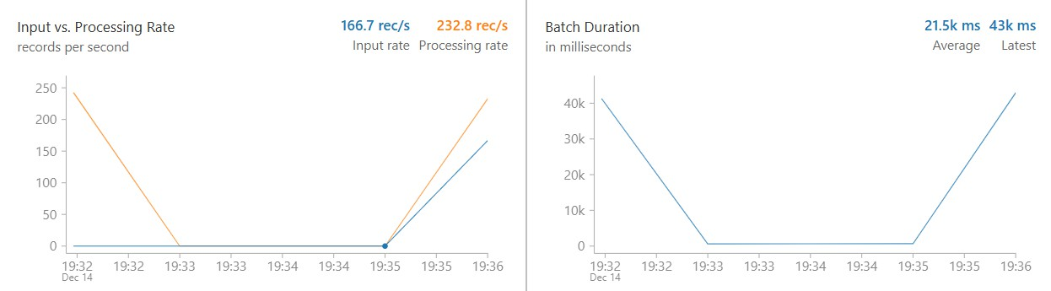
Analysis Results

Slide 11

Conclusion
The Real-Time Analytics Dashboard project demonstrates the power of integrating advanced big data processing frameworks, like Azure Databricks and PySpark, with real-time streaming platforms and visualization tools.
By leveraging Azure resources and technologies, we achieved seamless data ingestion, processing, and visualization of actionable insights in real time.
This project not only highlights the importance of automation, scalability, and security in handling dynamic data but also empowers stakeholders with critical insights for timely decision-making. It showcases a robust and scalable solution adaptable to various industries for monitoring trends, detecting anomalies, and driving operational efficiency.

Slide 12


